Slide 1




NEXT GEN EMPLOYABILITY PROGRAM
Creating a future-ready workforce
Team Members
College Name
Student Name : J.Vigneswar
Student ID : au711021205021
Info Institute of Engineering

Slide 2

CAPSTONE PROJECT SHOWCASE
Project Title
Notes Sharing Web Application using Django Framework
Abstract | Problem Statement | Project Overview | Proposed Solution | Technology Used | Modelling & Results | Conclusion

Slide 3
Abstract
The proposed project aims to develop a sophisticated web application using the Django framework to facilitate the seamless sharing and management of notes. In today's fast-paced digital world, the need for efficient note-taking and collaboration tools has become increasingly crucial. This application seeks to address this need by providing a user-friendly platform where individuals and teams can create, organize, and share notes securely over the internet. By leveraging Django's robust features and incorporating modern web technologies, the project endeavors to offer an intuitive and comprehensive solution for note-sharing needs.
Source :https://github.com/Vigneswar143/naan-mudhalvan-fullstack-webdevelopment.git

Slide 4
Problem Statement
Traditional note-taking methods often lack the flexibility and accessibility required in modern collaborative environments. Users face challenges in securely storing and sharing their notes, especially when working in teams or across different devices. Existing note-sharing platforms may suffer from usability issues, security vulnerabilities, or limited features, thus failing to meet the evolving demands of users. Therefore, there is a pressing need for a sophisticated web application that addresses these shortcomings and provides a seamless, secure, and collaborative environment for note-sharing activities.
Source : https://github.com/Vigneswar143/naan-mudhalvan-fullstack-webdevelopment.git

Slide 5
Project Overview
The Notes sharing web application built on the Django framework offers a feature-rich platform for users to create, edit, and share notes effortlessly. Key features include user authentication, role-based access control, real-time collaborative editing, version control, and advanced search functionalities. The application employs Django's powerful ORM for data modeling and integrates with popular front-end frameworks for a modern and responsive user interface. By emphasizing usability, security, and collaboration, the project aims to deliver a comprehensive solution that caters to the diverse needs of individuals and teams in various domains.
Source :https://github.com/Vigneswar143/naan-mudhalvan-fullstack-webdevelopment.git

Slide 6
Proposed Solution
.
The proposed solution utilizes the Django framework's capabilities to develop a robust and scalable notes sharing platform. User authentication and authorization are implemented using Django's built-in authentication system, ensuring secure access to the application's features. Notes are managed using Django models, allowing for efficient organization and retrieval of data. Real-time collaborative editing is facilitated through technologies like WebSocket or Django Channels, enabling multiple users to collaborate on the same note simultaneously. Encryption techniques are employed to safeguard user data, while version control mechanisms track changes and revisions to notes, ensuring data integrity and accountability
Source :https://github.com/Vigneswar143/naan-mudhalvan-fullstack-webdevelopment.git

Slide 7
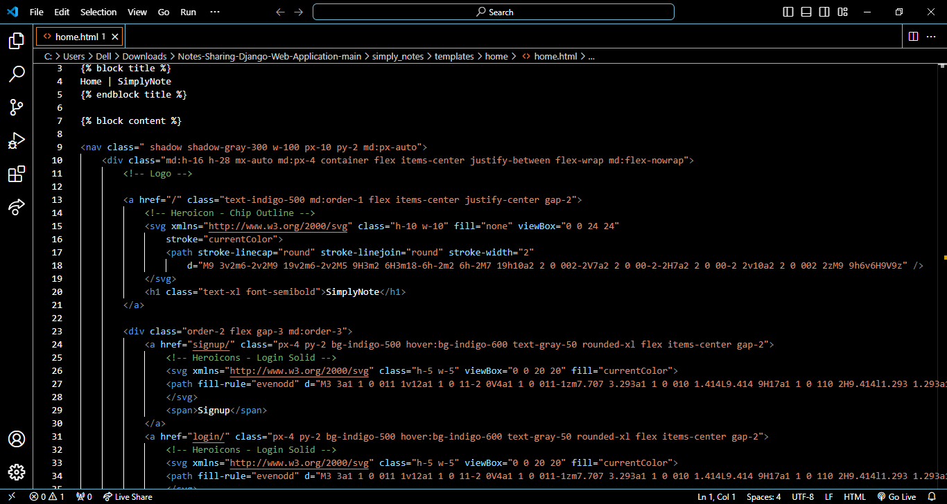
Source :https://github.com/Vigneswar143/naan-mudhalvan-fullstack-webdevelopment.git

Slide 8
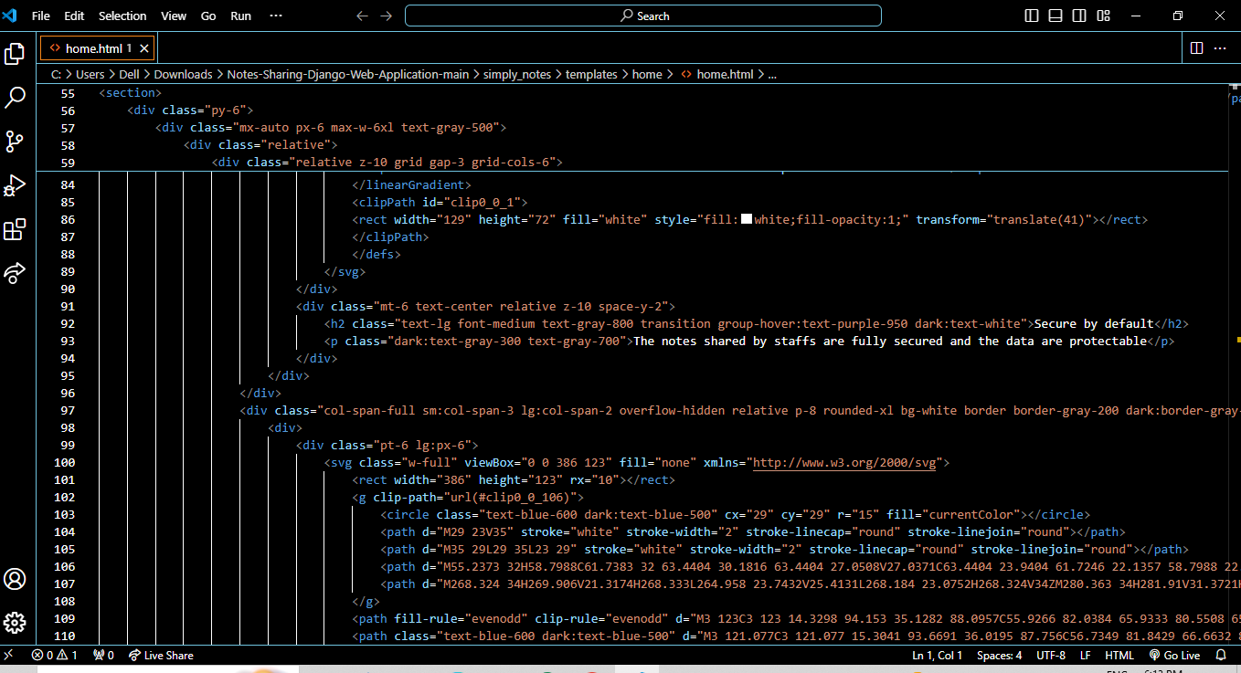
Source :https://github.com/Vigneswar143/naan-mudhalvan-fullstack-webdevelopment.git

Slide 9


Technology Used
Front-end
Back-end
Source :https://github.com/Vigneswar143/naan-mudhalvan-fullstack-webdevelopment.git

Slide 10
Modelling & Results
Initial modeling results indicate the successful implementation of core functionalities within the application. User authentication, note creation, editing, and sharing functionalities are tested and validated. Performance metrics demonstrate satisfactory response times and scalability under moderate user loads. Further optimization and testing are planned to ensure the application's stability and reliability under varying conditions.
Source : https://github.com/Vigneswar143/naan-mudhalvan-fullstack-webdevelopment.git

Slide 11
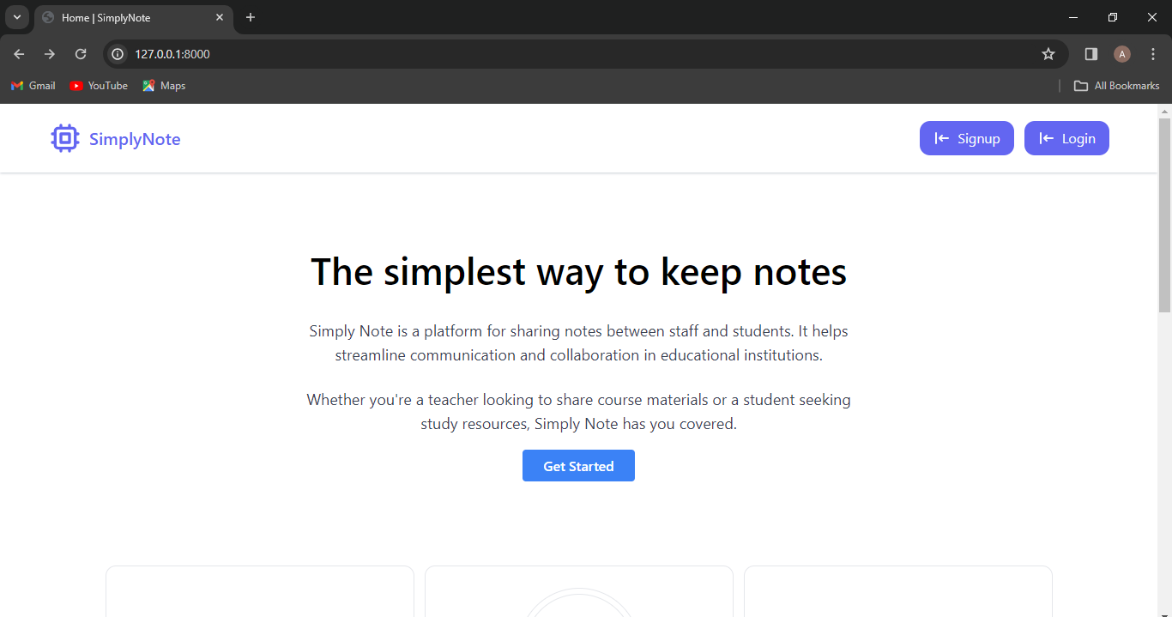
Homepage

Slide 12
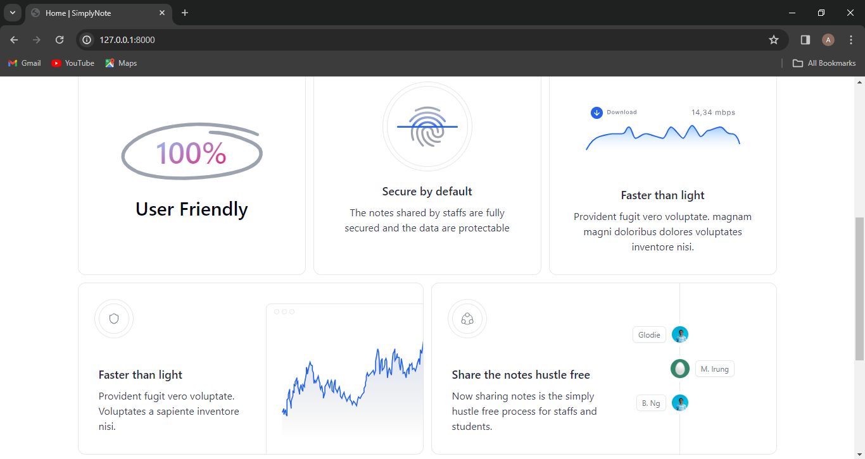
About-Us-Page

Slide 13
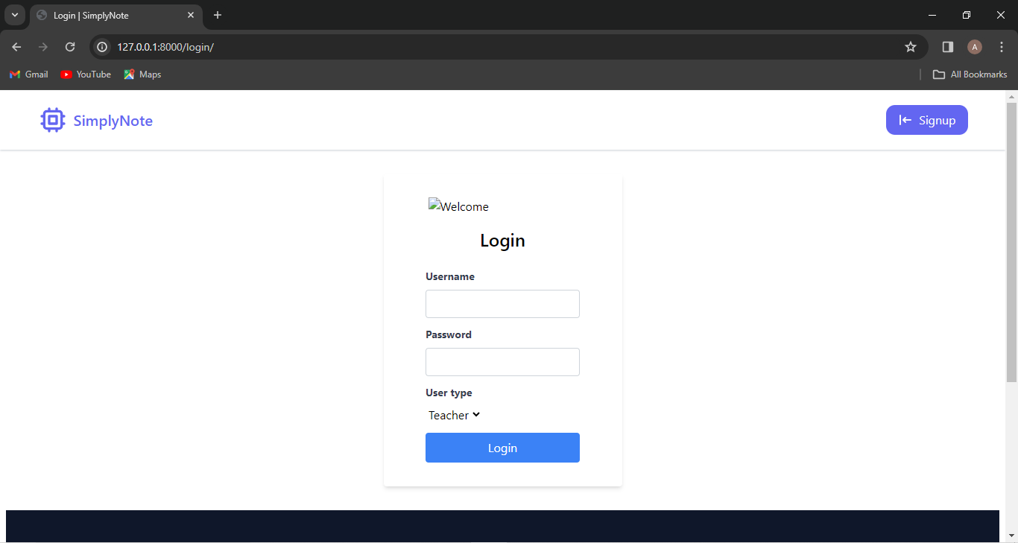
Login-Page

Slide 14
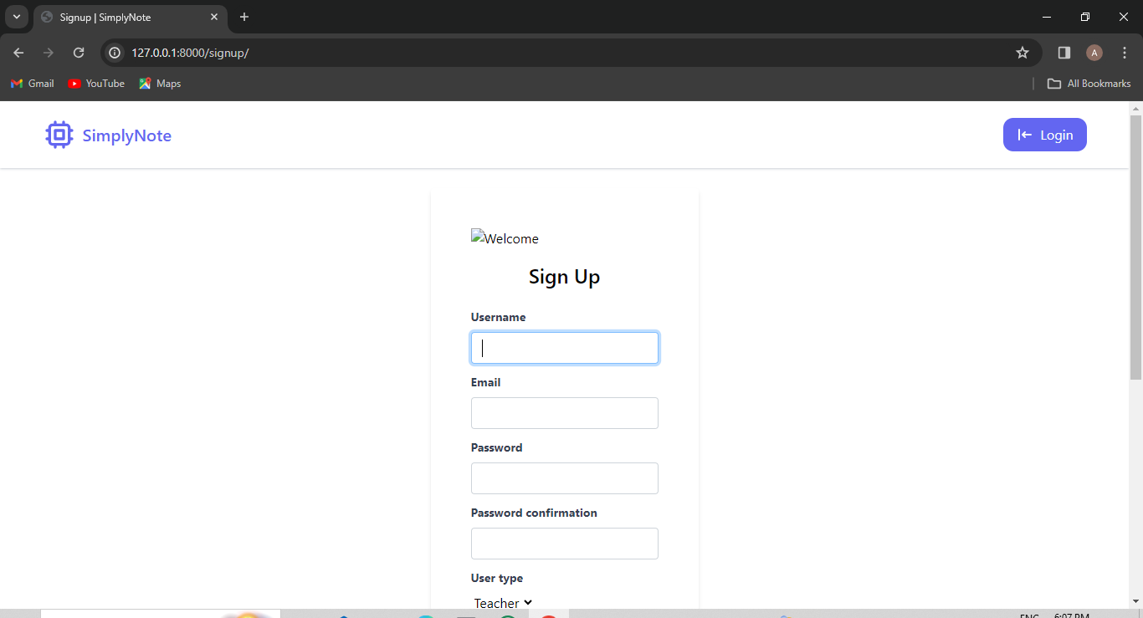
Signup-Page

Slide 15
Future Enhancements:
Future enhancements for the Notes sharing web application may include:
Integration of additional collaboration tools such as chat or comments to facilitate communication among users.
Implementation of advanced search and filtering capabilities to enhance note discovery and organization.
Support for multimedia content within notes, allowing users to embed images, videos, and other rich media.
Development of mobile applications for seamless access to notes on smartphones and tablets.
Incorporation of machine learning algorithms for intelligent note organization, categorization, and recommendation based on user preferences and behavior.

Slide 16
Conclusion
In conclusion, the Notes sharing web application developed using the Django framework represents a significant step towards addressing the challenges associated with note-taking and collaboration in modern digital environments. By leveraging Django's robust features and incorporating cutting-edge technologies, the application offers a comprehensive solution that meets the diverse needs of users across different domains. With ongoing development and enhancements, the project aims to become a leading platform in the field of digital note management, empowering users to streamline their workflows and collaborate effectively in a secure and intuitive environment.
Source :https://github.com/Vigneswar143/naan-mudhalvan-fullstack-webdevelopment.git

Slide 17
Thank You!
Notes:
Thank You !!

